Slide 1

The Issues With More Gun Control
By: Ryan D’souza

Slide 2
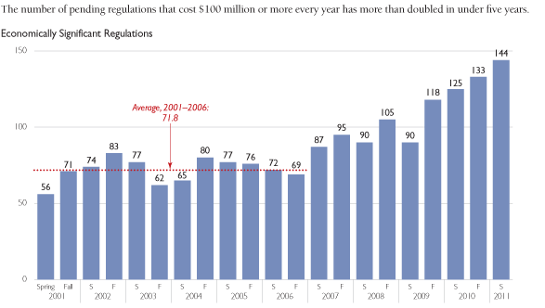
Regulation Has High Costs
144 * $100,000,000 → $14,400,000,000 ($14.4 Billion per year)

Slide 3
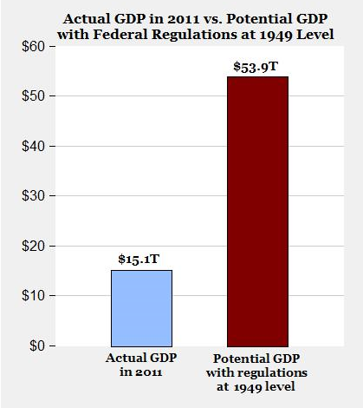
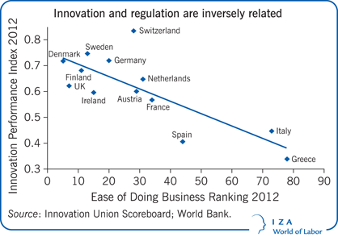
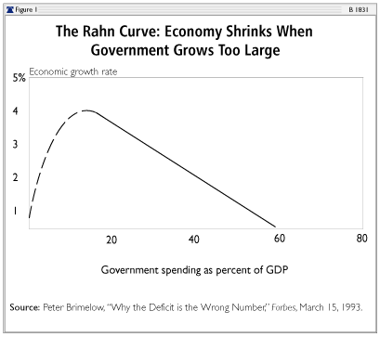
And Inhibits Economic Growth
More regulation results in smaller profits, and decreases incentives to innovate

Slide 4
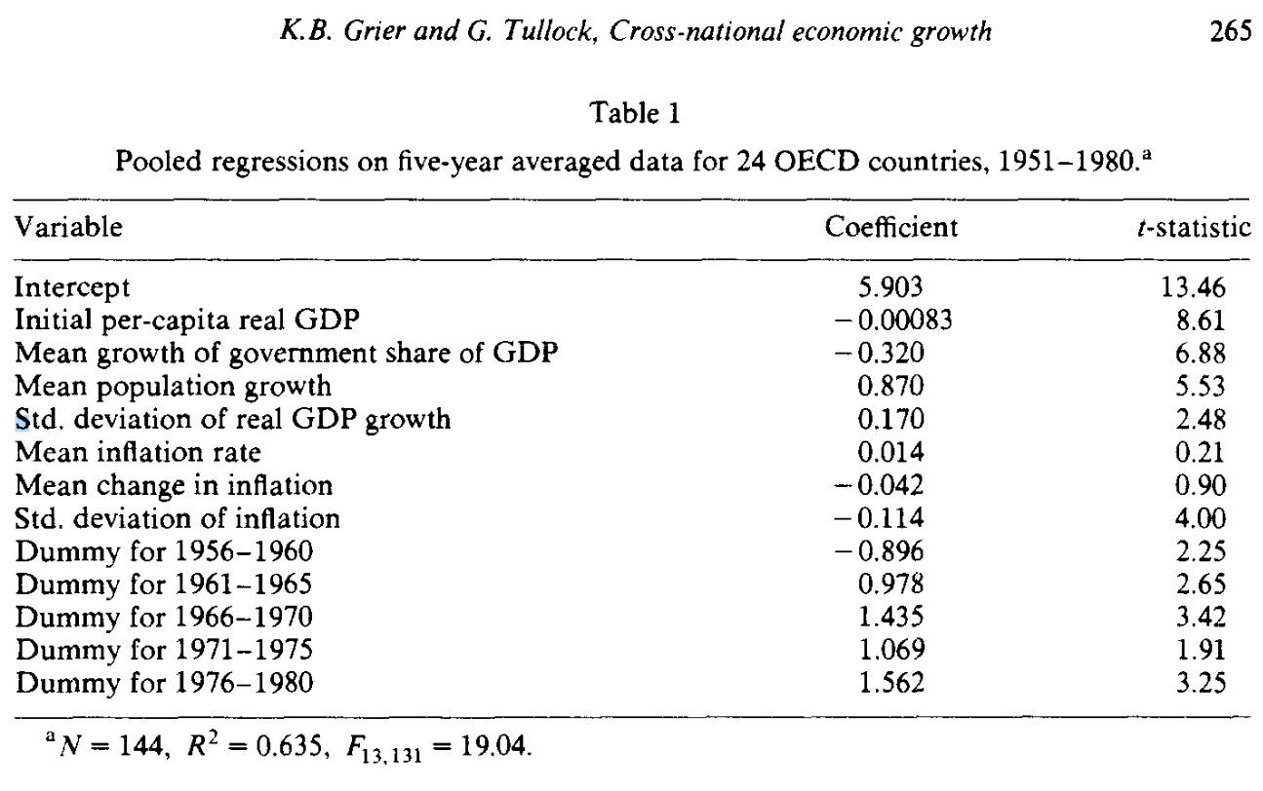
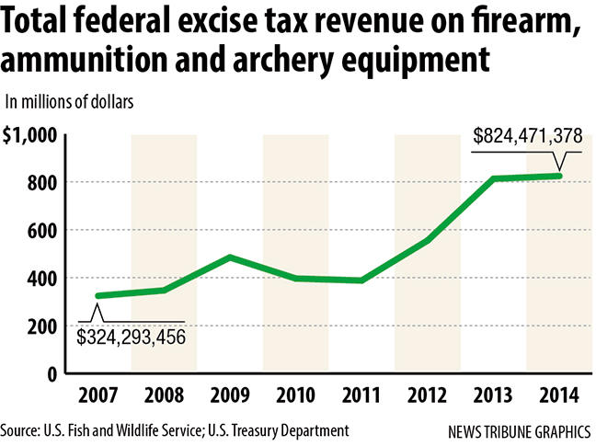
More on That
A (highly significant) coefficient of -0.32 for growth of government share of GDP and R^2 value of 0.635, implies that smaller government growth as a % of GDP results in more GDP growth
The increase in gun regulation has slowed the government’s revenue from weapon sale – more regulation will give the government even less revenue

Slide 5
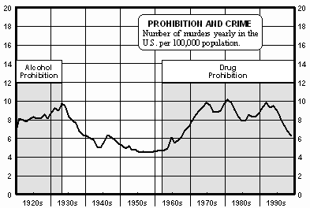
Myth: Prohibition Decreases Crime Rates
Correct: Fatal crime rates were at all-time highs when alcohol and various drugs were banned because they were “dangerous”. It seems like prohibition is more dangerous than those substances.

Slide 6
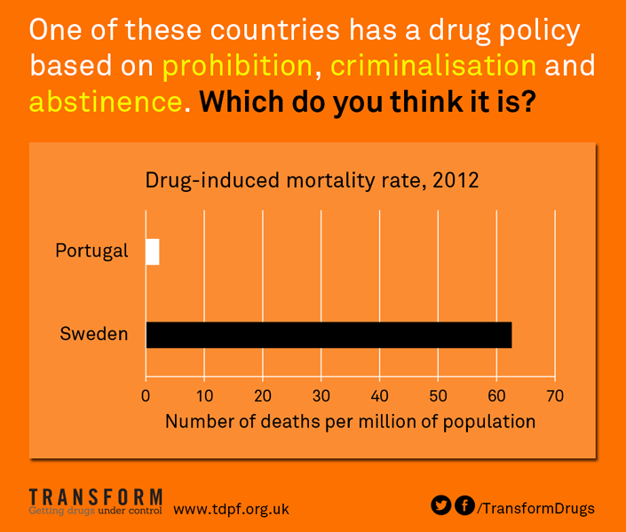
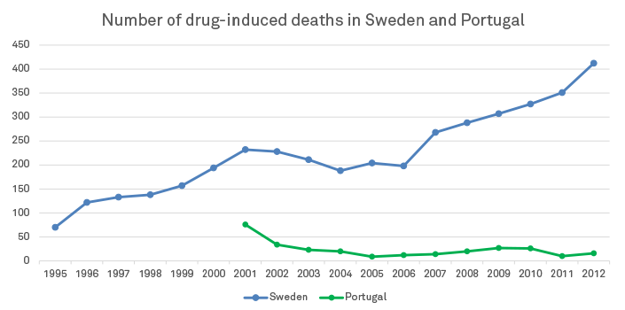
Myth: Prohibition Decreases (Safe) Usage
Portugal’s population is 11% larger than Sweden’s population, yet Sweden’s number of drug-induced deaths is more than 800 times that of Portugal’s
Sweden has a “zero-tolerance” policy for illegal drugs, while Portugal doesn’t consider a supply under “10 days usage” a criminal offense

Slide 7
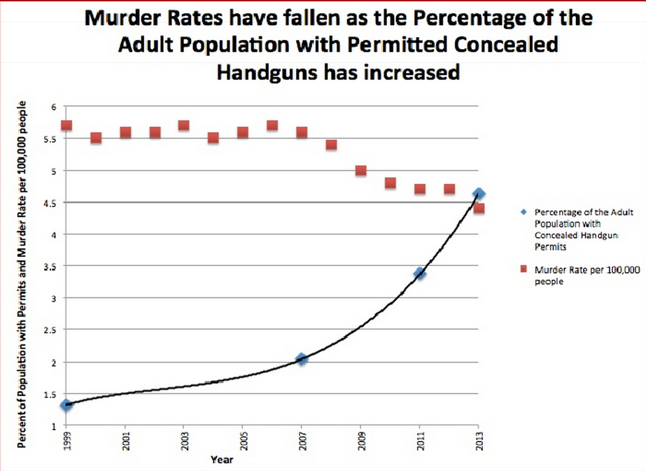
Fact: Guns Save Lives

Slide 8

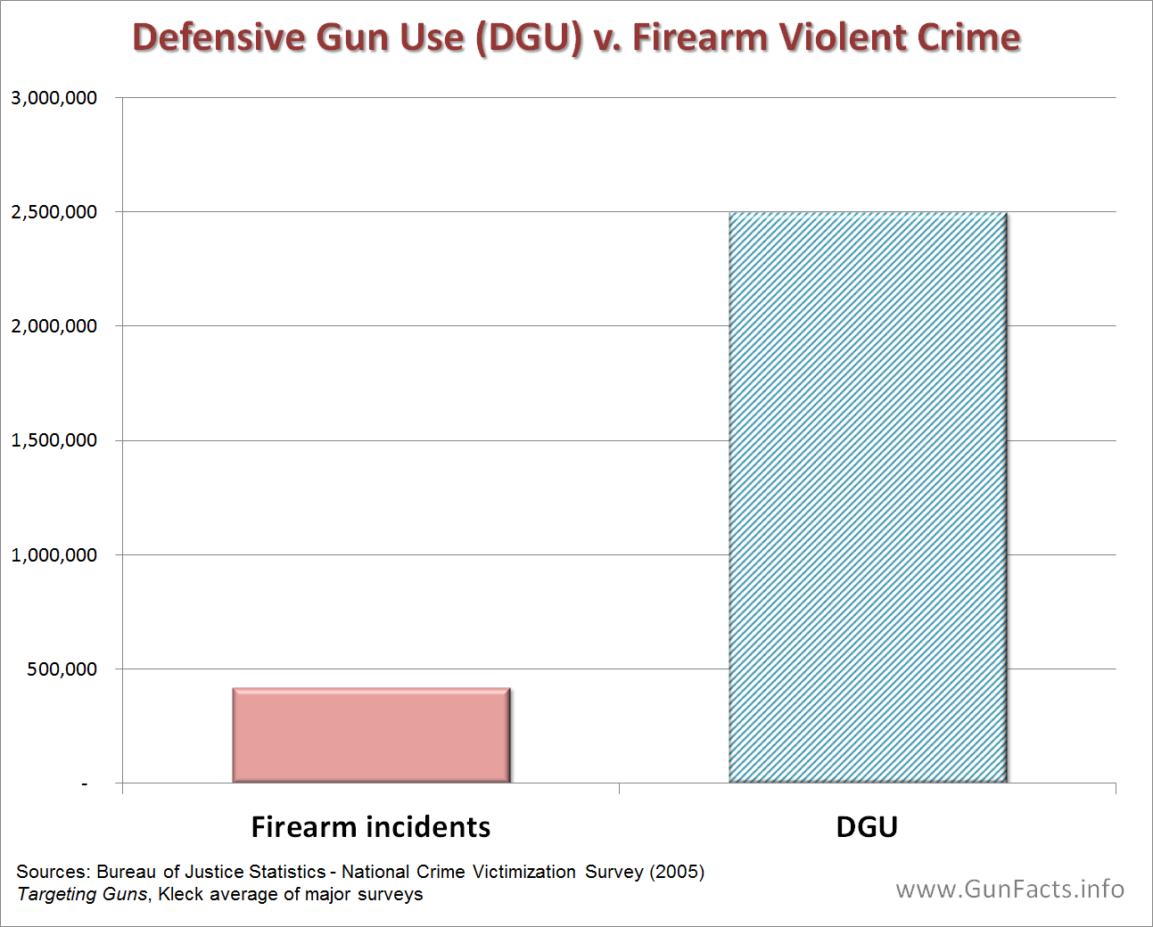
Fact: Guns Protect People

Slide 9
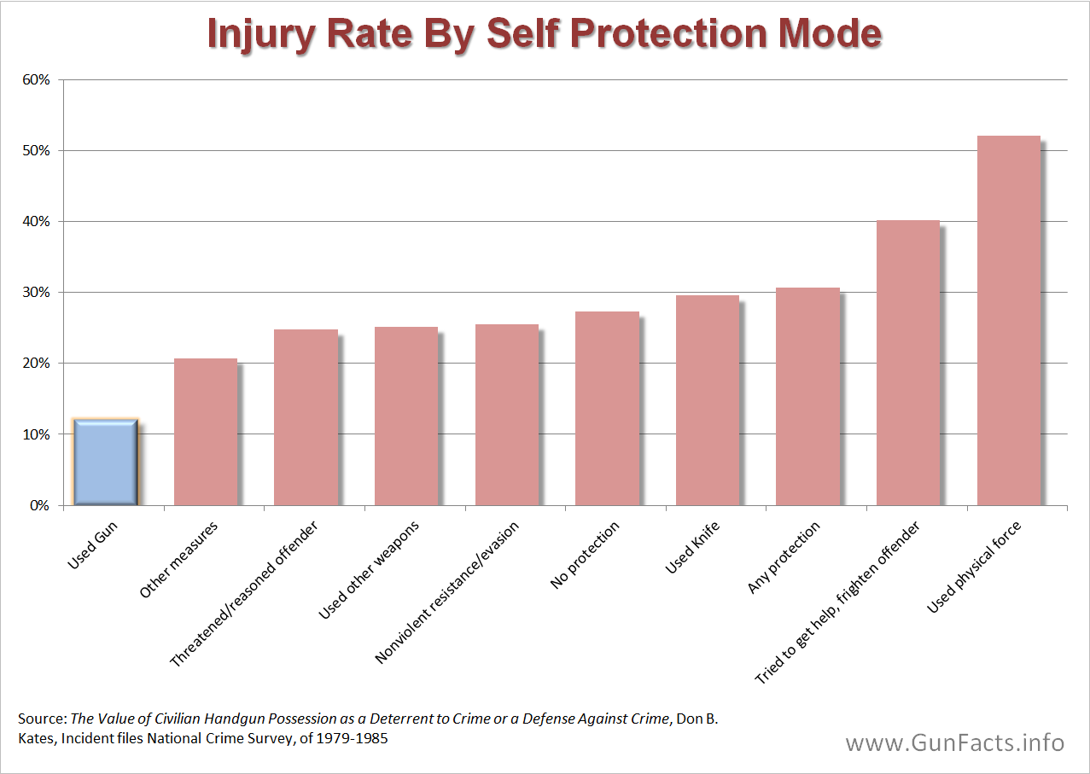
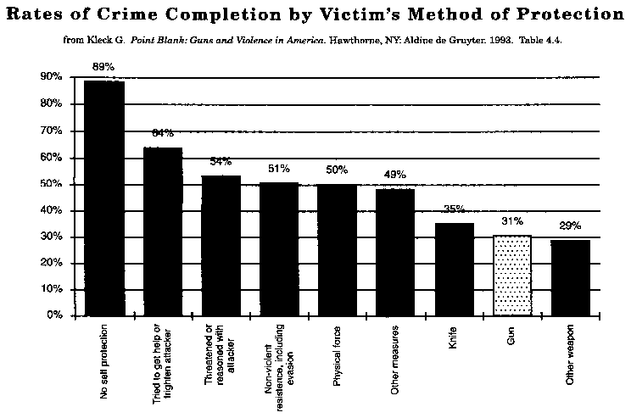
Fact: Guns Are Safer For Defense
Barely 31% of crimes are completed when the victim is able to protect themselves with a gun, while 36% and 89% of crimes are completed when the victim has either a knife or no weapon

Slide 10
Conclusion
There is no benefit to further regulating gun control
  Statistically significant research has proven that:
    Regulation decreases innovation and economic growth
    Regulation does not decrease crime/death rates
    Guns keep people safer and more protected

Slide 11
Sources
http://www.heritage.org/research/reports/2011/07/red-tape-rising-a-2011-mid-year-report
http://wol.iza.org/articles/entrepreneurs-and-their-impact-on-jobs-and-economic-growth/long
http://centerforregulatorysolutions.org/fact-of-the-day-january-24-2014/
http://www.heritage.org/research/reports/2005/03/the-impact-of-government-spending-on-economic-growth
http://www.ifn.se/Wfiles/wp/wp503.pdf
http://faculty-staff.ou.edu/G/Kevin.B.Grier-1/JME1989.pdf
http://www.cato.org/pubs/pas/pa-157.html
http://www.tdpf.org.uk/blog/drug-policy-sweden-repressive-approach-increases-harm

